Slide 1
Time series analysis
Unit 07 lecture
Fall 2025 EAS 42000 / A4200
Nov 10 2025
Prof. Spencer Hill

Slide 2
Time series analysis
Time series
Stochastic processes
Autoregressive models (Wednesday’s lab)

Slide 3
Time series analysis
Time series
Stochastic processes
Autoregressive models

Slide 4
A time series (or timeseries) is, well, a series of observations sequenced in time
I.e. a collection of observations that is sequenced in time
Denoted X₁, X₂, etc., where subscript denotes the order in time
That said, most of the techniques we’ll discuss also apply to things indexed in space
In that case, X₁, is the value at location 1, X₂, is the value at location 2, etc.

Slide 5
Example time series we’ll be using: the NINO3.4 index
Next few slides: what NINO3.4 is

Slide 6
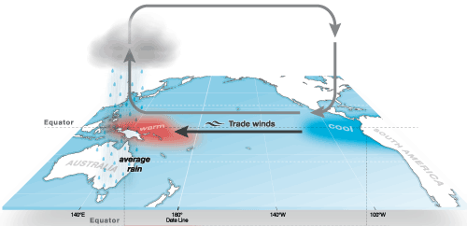
ENSO is a sloshing east and west of warm water in the equatorial Pacific ocean
ENSO = El Niño-Southern Oscillation
“neutral” ENSO
schematic
http://www.bom.gov.au/climate/enso/history/ln-2010-12/three-phases-of-ENSO.shtml

Slide 7
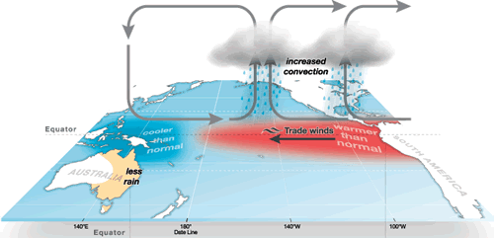
During El Niño events, eastern Pacific is unusually warm
“El Niño”
schematic

Slide 8
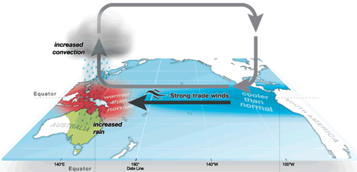
During La Niña events, eastern Pacific is unusually cold
“La Niña”
schematic

Slide 9
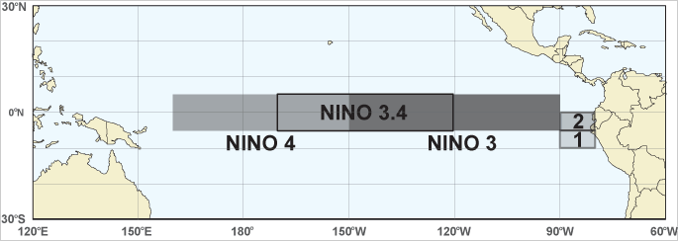
NINO3.4 is an index of ENSO, based on sea surface temperatures averaged over a box
https://images.app.goo.gl/5avnsSEubijorybW8

Slide 10
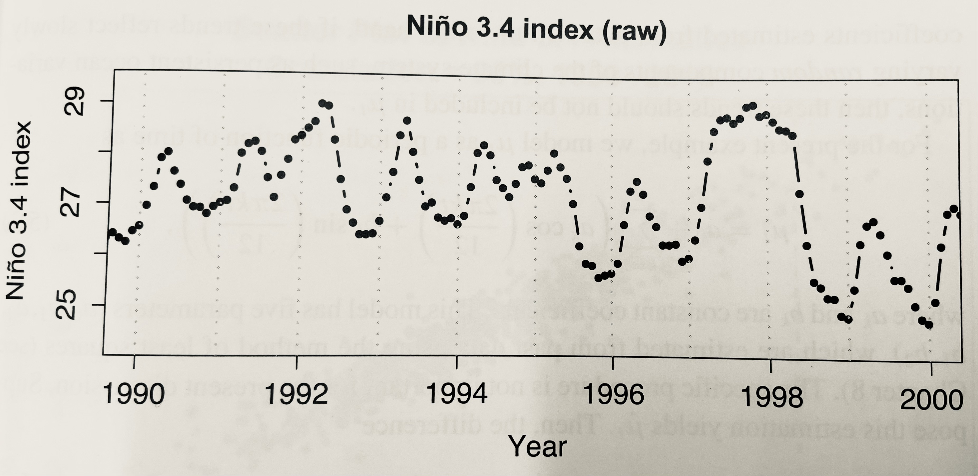
Here’s the monthly NINO3.4 index from 1988 to 2002
This and subsequent figure snapshots taken from Delsole and Tippett

Slide 11

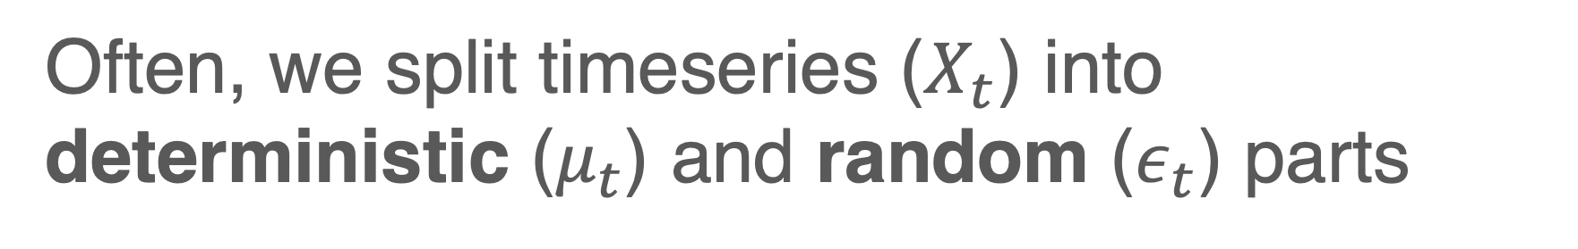
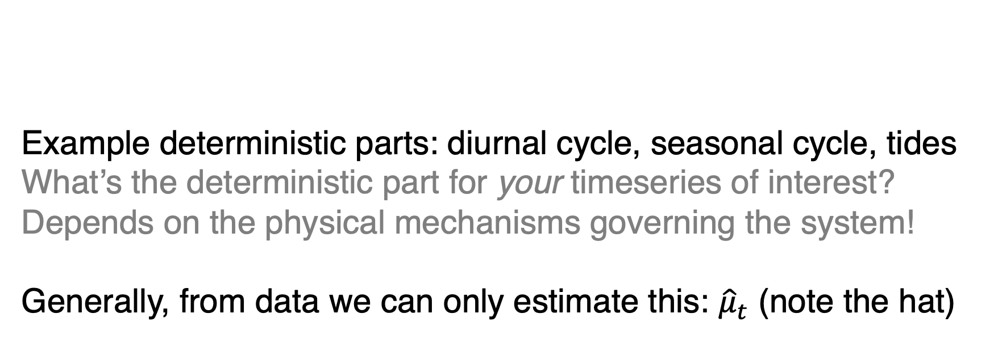
Often, we split timeseries ($X_{t}$) into deterministic ($μ_{t}$) and random ($ε_{t}$) parts
Example deterministic parts: diurnal cycle, seasonal cycle, tides
What’s the deterministic part for your timeseries of interest? Depends on the physical mechanisms governing the system!
Generally, from data we can only estimate this: ${\hat{μ}}_{t}$ (note the hat)

Slide 12
Often, we split timeseries ($X_{t}$) into deterministic ($μ_{t}$) and random ($ε_{t}$) parts
For NINO3.4, we’ll take the deterministic component to be the sum of once-annual and twice-annual cycles
Details of how this is done aren’t important

Slide 13
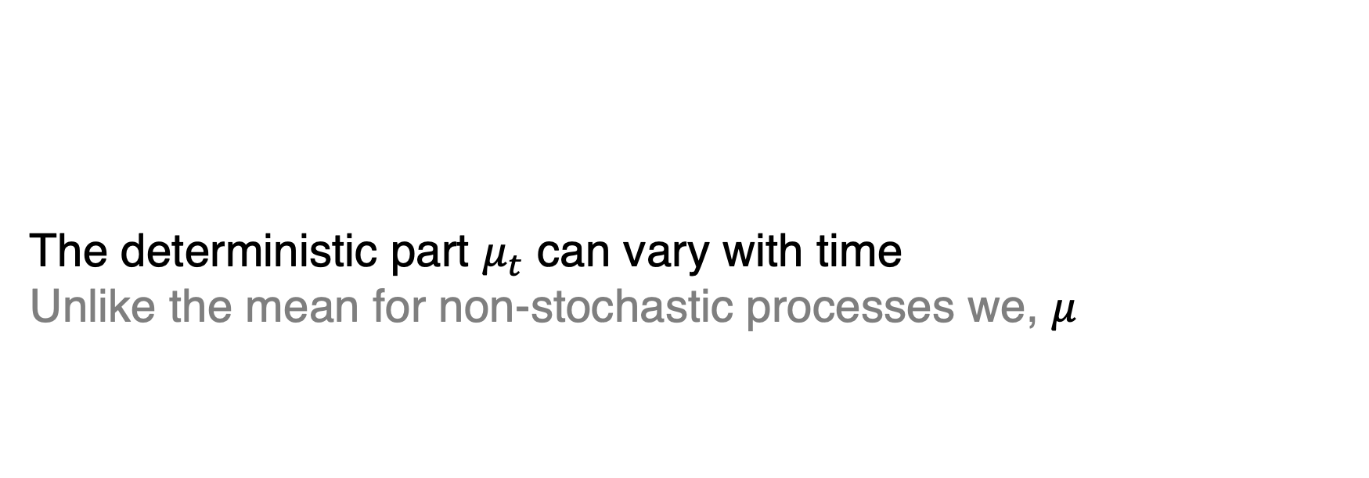
Often, we split timeseries ($X_{t}$) into deterministic ($μ_{t}$) and random ($ε_{t}$) parts
The deterministic part $μ_{t}$ can vary with time
Unlike the mean for non-stochastic processes we, $μ_{}$

Slide 14
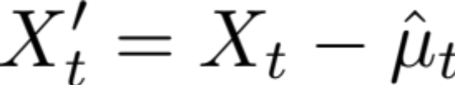
Difference between the time series and the estimated deterministic part is the anomaly
Anomaly X’_{t}:
Where the hat, as usual, on the deterministic part signifies that we have estimated it, rather than knowing it exactly

Slide 15
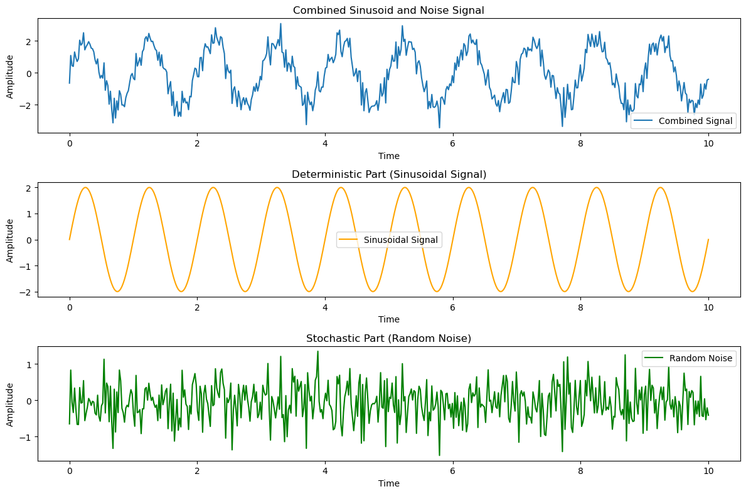
Toy example: repeating sine curve plus small-amplitude random noise
In this toy example, we do know the deterministic part exactly…because I created it myself!
But in real world examples we instead have to estimate it

Slide 16
Toy example: repeating sine curve plus small-amplitude random noise
Notice: the deterministic part varies with time
I.e. it’s not just a time average

Slide 17
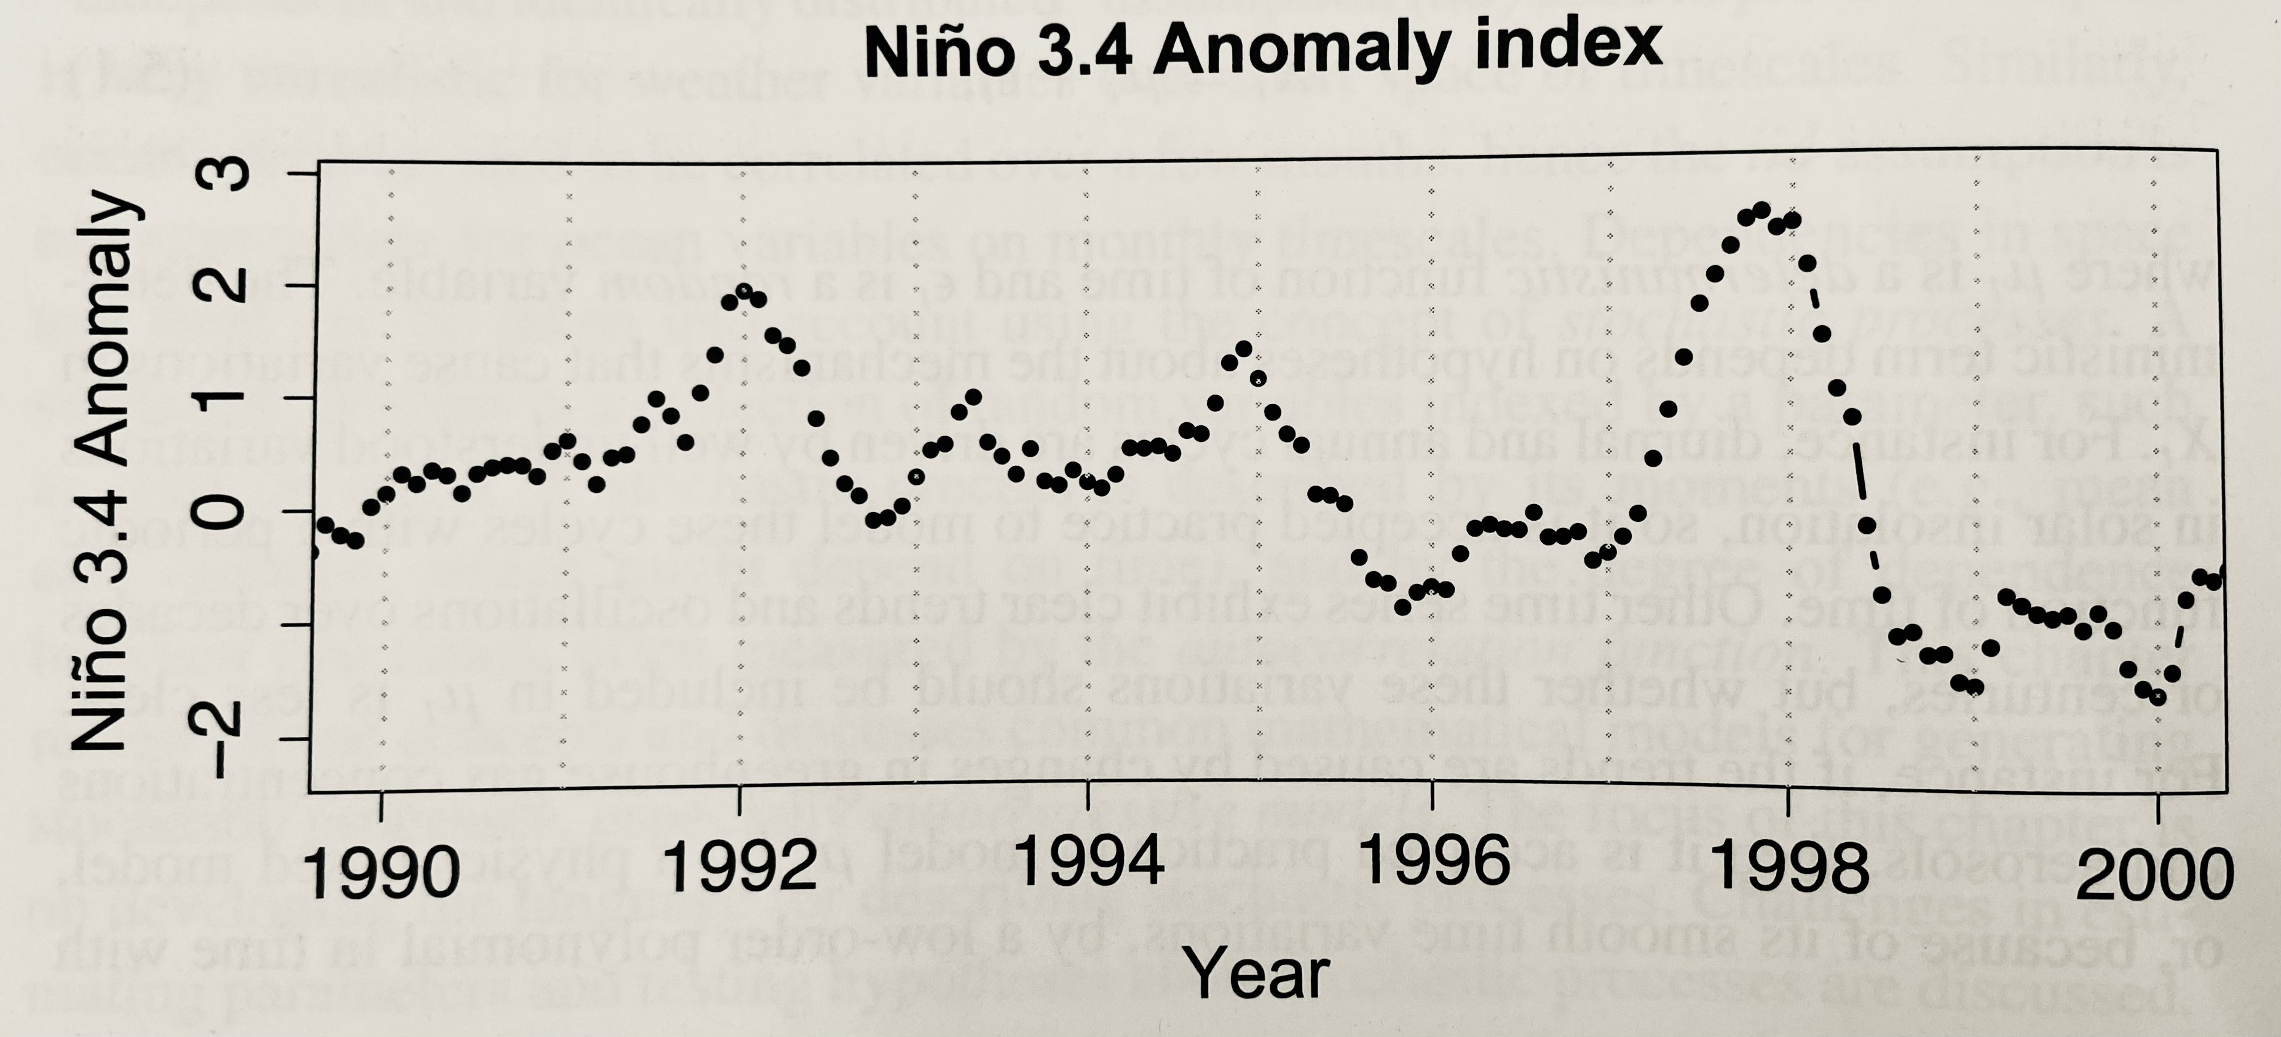
Resulting NINO3.4 anomaly timeseries
How would you describe it?

Slide 18
NINO3.4 anomaly timeseries is smooth: values don’t jump much from preceding one
I.e. the values are serially correlated
This implies we can predict future values from the present and/or past ones
By eye, at least one month or so, and imperfectly

Slide 19
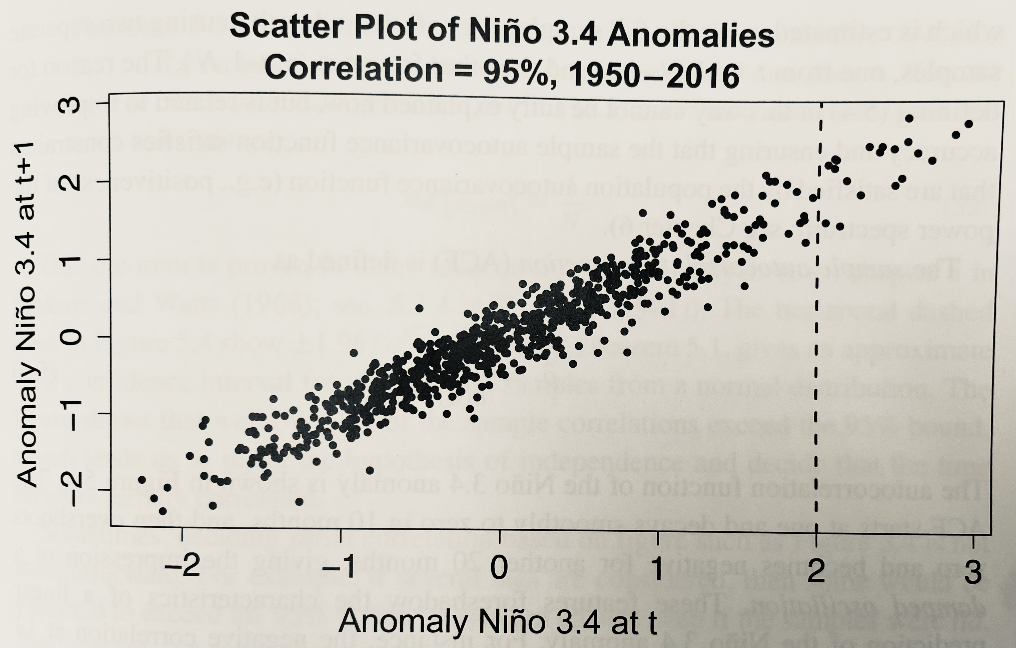
Another way of seeing this: scatter each value X_{t} against the next value X_{t+1}
Suppose the current value of the NINO3.4 anomaly was 2. Then empirically, what range of values can we expect next month’s value to take?
Answer: roughly between 1 and 2

Slide 20
Another way of seeing this: scatter each value X_{t} against the next value X_{t+1}
Now let’s go from this by-eye approach to quantitative analysis via autocovariance and autocorrelation
In this context, auto = self

Slide 21
Autocovariance measures how consecutive values of a timeseries co-vary
Measure of the covariance of a time series with a lagged version of itself
Lag is the number of timesteps separating two values. So lag=1 means each point with the one right after.
Notation: time lag denoted with tau: 𝜏
Depends on the lag
And is even in lag

Slide 22
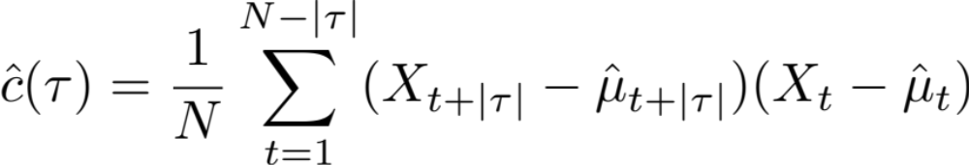
Autocovariance measures how consecutive values of a timeseries co-vary
Sample autocovariance function:
for

Slide 23
Autocovariance measures how consecutive values of a timeseries co-vary
Sample autocovariance function:
Notice: This is (basically) the sample covariance of X with itself at a fixed lag

Slide 24
Autocorrelation is to autocovariance as correlation is to covariance
Recall: correlation between two arrays X and Y amounts to the covariance between X and Y normalized by the standard deviations of X and Y
Autocorrelation and autocovariance are related similarly: autocorrelation of a timeseries is autocovariance normalized by the variance of that timeseries

Slide 25
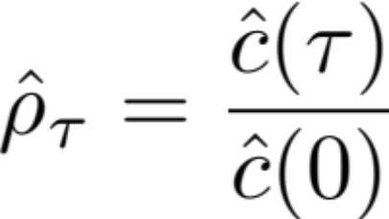
The autocorrelation function (ACF) gives the autocorrelation as a function of lag
Sample autocorrelation function:
i.e. the sample autocovariance at each lag divided by the sample autocovariance at zero lag

Slide 26
The autocorrelation function (ACF) gives the autocorrelation as a function of lag
Sample autocorrelation function:
Q: what is the sample autocovariance at zero lag?
A: the sample variance (but dividing by N rather than N-1)

Slide 27
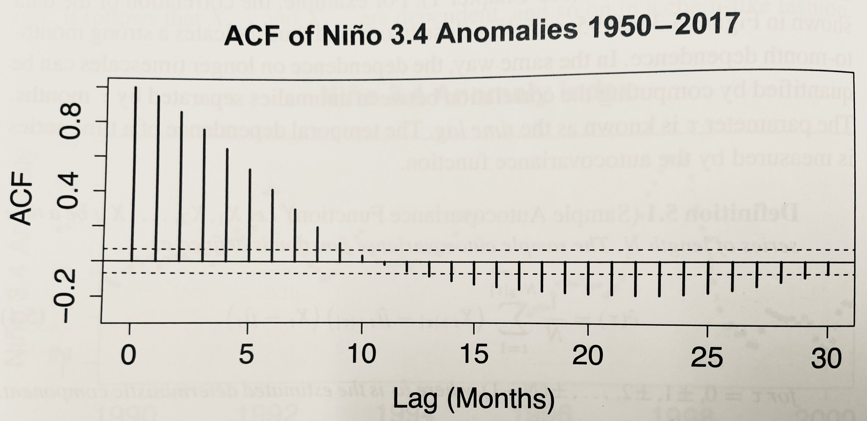
Sample ACF of the NINO3.4 anomalies:
What do you see?

Slide 28
Sample ACF of the NINO3.4 anomalies:
What do you see?
By definition, value at lag 0 is unity
As lag increases to ~10 months, lag decreases toward zero
And then overshoots! negative for ~12-28 months
Suggests a damped oscillation

Slide 29
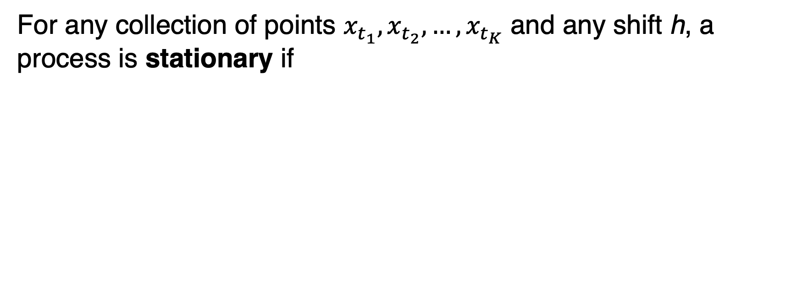
A timeseries is stationary if its statistical properties do not change with time
For any collection of points $x_{t_{1}},x_{t_{2}},…,x_{t_{K}}$ and any shift h, a process is stationary if

Slide 30
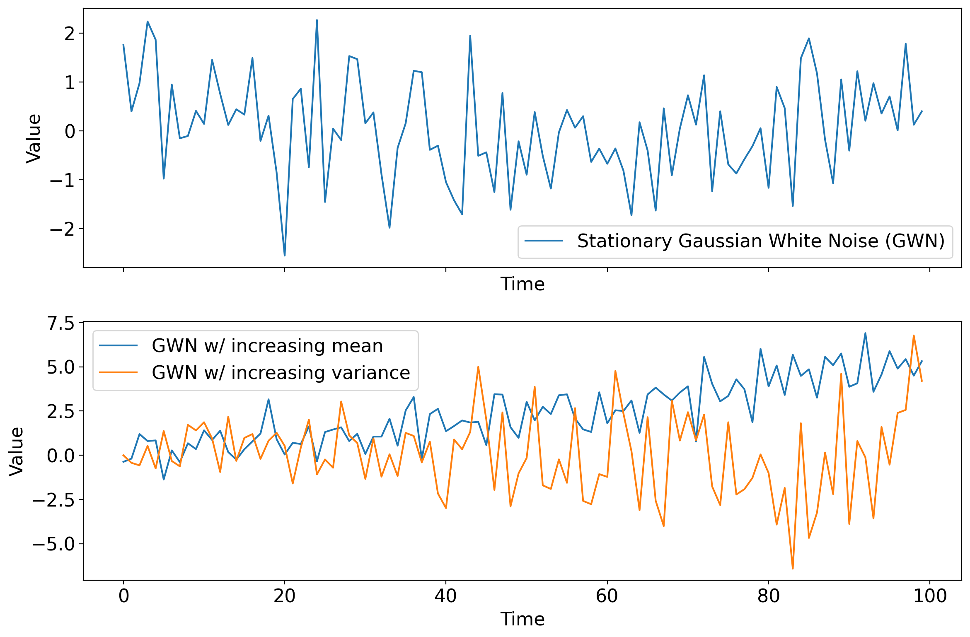
Example: one stationary, two nonstationary timeseries

Slide 31
Stationary: statistical relationships between points in time depend only on the lag

Slide 32
Many statistical techniques assume stationarity
Non-stationarity can lead to unreliable and spurious results
For example: hypothesis tests assume that each observation is independent of the others
But if observations are strongly serially correlated, this is violated, leading to inflated statistical significance of detected differences

Slide 33
If a time series is not stationary, it can often be transformed to stationarity
Physically based technique: given the deterministic component, compute anomalies from that component at each timestep
The resulting timeseries is not guaranteed to be stationary, but it should be much closer to it
Statistical techniques: will return to once we cover power spectra and Fourier decompositions

Slide 34
Time series analysis
Time series ✅
Stochastic processes
Autoregressive models
Spectral analysis

Slide 35
A stochastic process is an ordered collection of random variables
Where random variable means a collection of values where each value is determined at least in part by chance (hence random)
Effectively, we consider all data in EAS to be random variables
Stochastic process also known as random process, or simply a process

Slide 36
A stochastic process is characterized by its mean, variance, & relationship b/w timesteps
The distribution of a stochastic process is the joint distribution across all times: p(x₁, x₂,… x_{N})

Slide 37
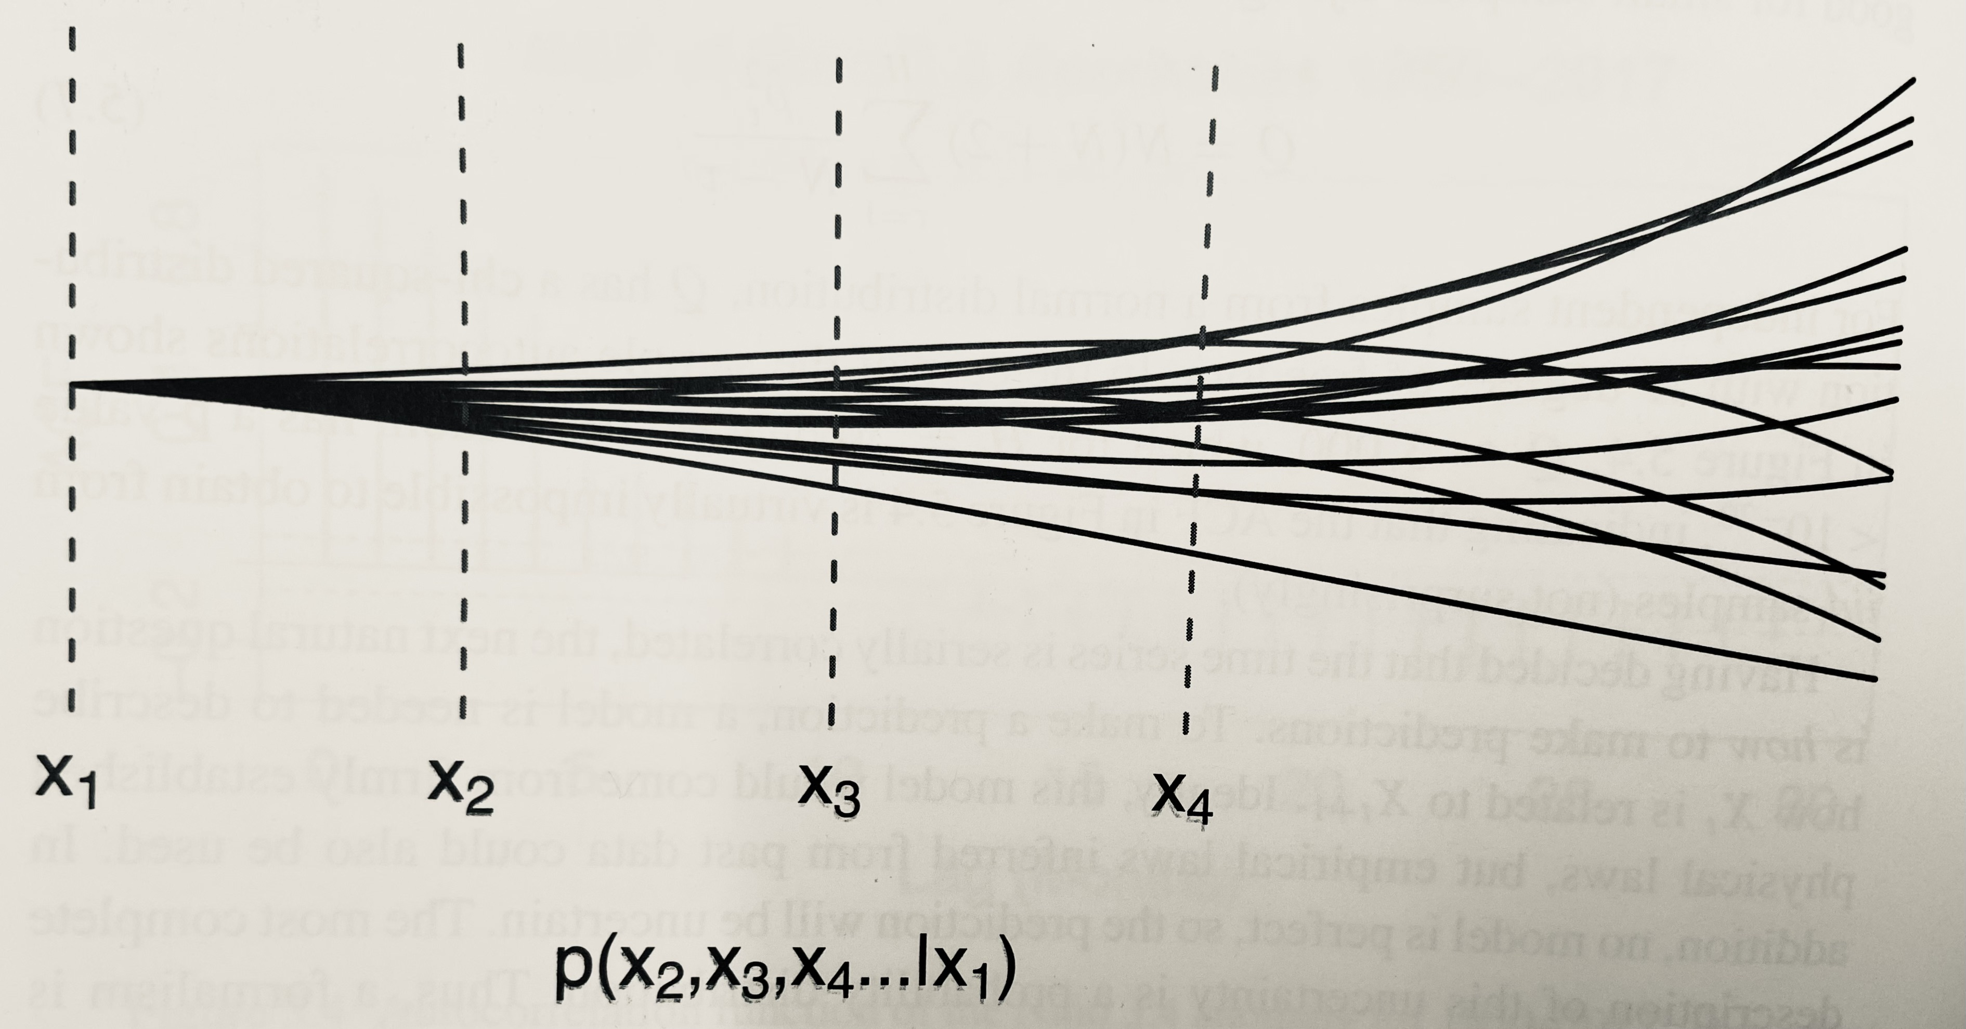
A collection of possible realizations of the stochastic process is called an ensemble

Slide 38
In weather, this is due to the Butterfly effect: tiny initial differences grow in time

Slide 39
The expectation of a stochastic process is an ensemble average (not time average)
I.e. an average over the joint distribution

Slide 40
Definition of climate as a stochastic process from Leith (1978):
One imagines an ensemble of Earths, each subjected to the same external influences, each with the same distribution of continents and oceans, and the weather on each going through normal fluctuations independently of the others.

Slide 41
Definition of climate as a stochastic process from Leith (1978):
One imagines an ensemble of Earths, each subjected to the same external influences, each with the same distribution of continents and oceans, and the weather on each going through normal fluctuations independently of the others. One next imagines that the distribution of states … can change relatively slowly owing to changing external influences.
.

Slide 42
Definition of climate as a stochastic process from Leith (1978):
One imagines an ensemble of Earths, each subjected to the same external influences, each with the same distribution of continents and oceans, and the weather on each going through normal fluctuations independently of the others. One next imagines that the distribution of states … can change relatively slowly owing to changing external influences. The climate is then defined in terms of averages over this ensemble.
.

Slide 43
Definition of climate as a stochastic process from Leith (1978):
One imagines an ensemble of Earths, each subjected to the same external influences, each with the same distribution of continents and oceans, and the weather on each going through normal fluctuations independently of the others. One next imagines that the distribution of states … can change relatively slowly owing to changing external influences. The climate is then defined in terms of averages over this ensemble. It is immediately evident that this ensemble-averaged climate is an ideal theoretical concept inaccessible by direct observations …

Slide 44
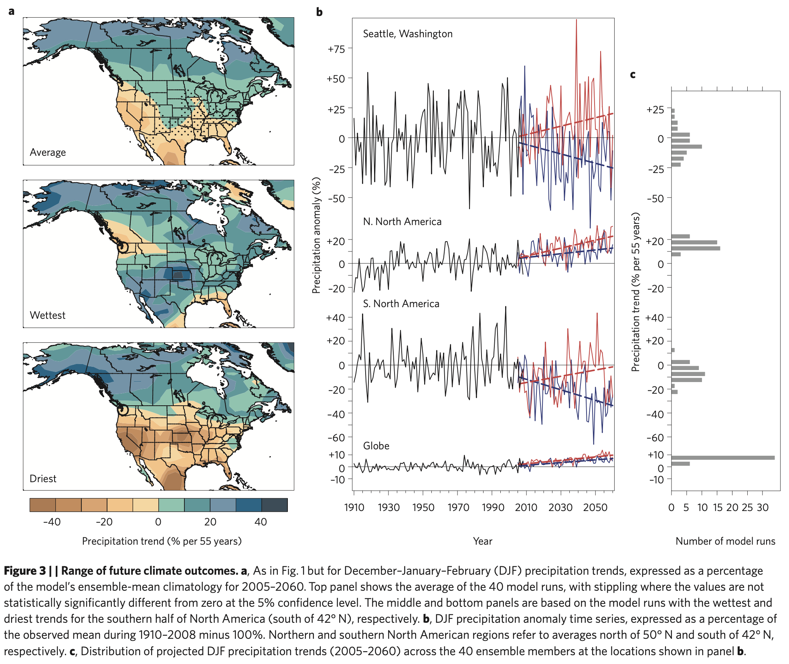
Ensembles in climate modeling: Deser et al 2012 https://doi.org/10.1038/nclimate1562
Role of internal variability in projections of future changes in precipitation caused by climate change
They perform the exact same simulation in the exact same climate model 40 times: an ensemble
But each ensemble member starts from a slightly different initial condition

Slide 45
Ensembles in climate modeling: Deser et al 2012 https://doi.org/10.1038/nclimate1562
Because of the butterfly effect (i.e. chaos), those teeny initial differences grow into changes in all of the world’s weather patterns within a week or so
This is internal variability.
This paper asks: how does that internal variability influence rainfall trends?

Slide 46
For the globe as a whole, this internal “noise” makes little difference on the precip trends
Red and blue = simulations with the biggest increase and least increase across all 40

Slide 47
For the globe as a whole, this internal “noise” makes little difference on the precip trends
“random” fluctuations at individual points cancel out when averaging the whole globe

Slide 48
But at any particular location, such as Seattle, this “noise” can win out over the forced trend
Red and blue = simulations with the biggest increase and biggest decrease across all 40

Slide 49
Maps of the local precipitation trends in these simulations
(top) average across all 40 ensemble members
(middle) the member with the largest positive trend in precipitation over N America
(bottom) the member with the most negative trend in precipitation over N America

Slide 50
Time series analysis
Time series ✅
Stochastic processes ✅
Autoregressive models: Wednesday’s lab

