Slide 1
Hypothesis tests
Lecture 06
November 3, 2025
EAS 42000 / A4200, Fall 2025
Prof. Spencer Hill

Slide 2
Let’s look at Central Park annual snow fall during 1900-1919 vs. 2000-2019
We want to know: did the amount of snow falling each year change in a meaningful way from the first period to the second?
After all, a lot of factors changed between those two periods: global warming, buildup and expansion of New York City, etc.
So perhaps those changed factors result in there being more snow lately than before (or less!)

Slide 3
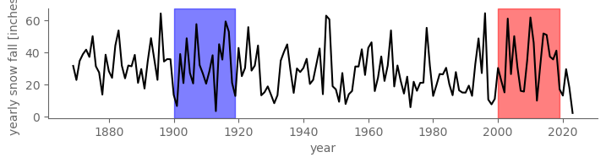
Let’s look at Central Park annual snow fall during 1900-1919 vs. 2000-2019
We want to know: did the amount of snow falling each year change in a meaningful way from the first period to the second?

Slide 4
Let’s look at Central Park annual snow fall during 1900-1919 vs. 2000-2019
The means over these two periods are different: 30.7” vs. 34.4”
So, case closed? On average, 3.8” more snow in recent period
Let’s publish a paper in Nature attributing this to global warming 😜
No! It’s possible that this 3.8” difference was random
And that the causes of snow fall didn’t actually change much

Slide 5
Let’s look at Central Park annual snow fall during 1900-1919 vs. 2000-2019
It’s possible that this 3.8” difference was random
And that the causes of snow fall didn’t actually change much
In other words: it is possible that the population was the same for 1900-1919 as for 2000-2019
And that the differences in the two samples was by chance

Slide 6
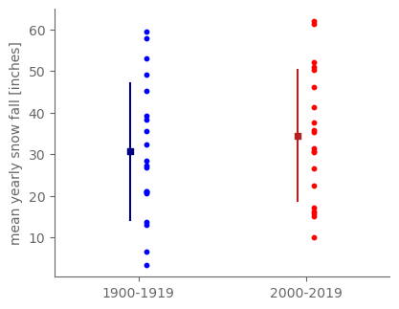
Let’s look at Central Park annual snow fall during 1900-1919 vs. 2000-2019
Let’s plot the values for each year separately for the two periods, and overlay the sample means +/- the sample standard deviations:
Each dot = 1 year

Slide 7
Let’s look at Central Park annual snow fall during 1900-1919 vs. 2000-2019
So, the means are different, but there’s a lot of scatter within each period and overlap between the two periods
So then what?
Hypothesis testing is the way we quantitatively estimate the contributions from randomness vs. an actual meaningful difference between the two samples

Slide 8
What we’re covering today:
Decision rules and p values
The t test: testing difference in means

Slide 9
What we’re covering today:
Decision rules and p values
The t test: testing difference in means

Slide 10
It’s impossible to infer the population parameters with certainty
Our CP snow hypothesis: annual snow fall in 1900-1919 was drawn from a different population than was annual snow fall in 2000-2019
But this is impossible to prove/disprove with certainty
Why? Any finite sample could, in principle, come from any number of populations, by random chance
Including each of these two samples

Slide 11
But we still want/need to either accept or reject our hypotheses somehow
For this example, making such a decision might not seem important, but in the real world decisions matter!
E.g. whether PM2.5 (air pollution) concentrations in a sample downwind of a power plant is higher than elsewhere nearby
How the company should be held accountable depends on whether the answer is “Yes” or “No”

Slide 12
We always test the null hypothesis: that the two populations are the same
Usually denoted H₀: H₀ = the two samples were drawn from the same population
From the word “null”, think “no difference”
In contrast with the alternative hypothesis: usually, this is that the two samples were drawn from different populations
Though it can be more precise than that

Slide 13
So we make a decision rule: a threshold value of our test statistic to accept/reject H₀
More detail shortly on test statistic. For now: it’s the number we compute that tells us how likely the hypothesis is true or not
We pick a threshold value of the statistic in advance, and use that to split all possible values into two regions: acceptance and rejection
In advance: to avoid “fishing” for the answer we want

Slide 14

Now let’s actually compute the test statistic
We’re interested in the difference between the two means:
Upshot: the test statistic for differences in sample means follows Student’s t distribution (or just “t” distribution)
So the resulting test is called a t test

Slide 15
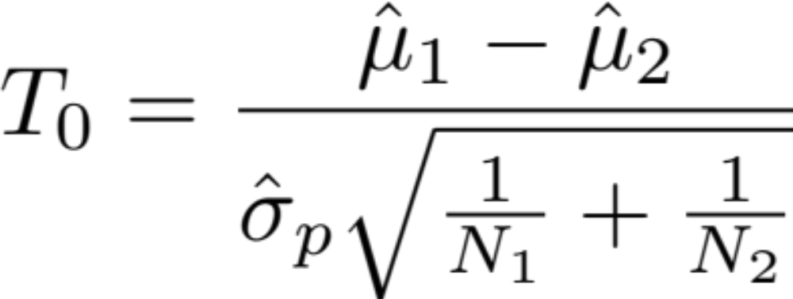
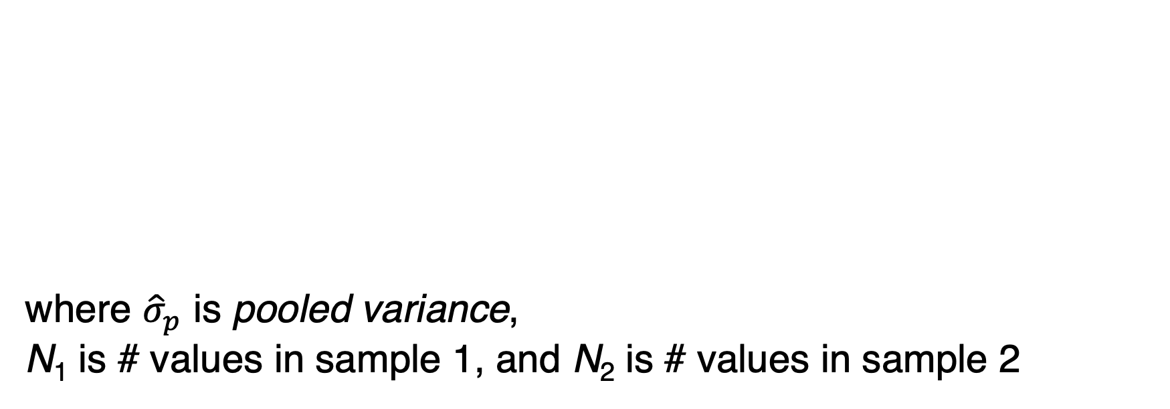
The t statistic, denoted T₀, is the difference in means normalized by a measure of variance
where ${\hat{σ}}_{p}$ is pooled variance,
N₁ is # values in sample 1, and N₂ is # values in sample 2

Slide 16
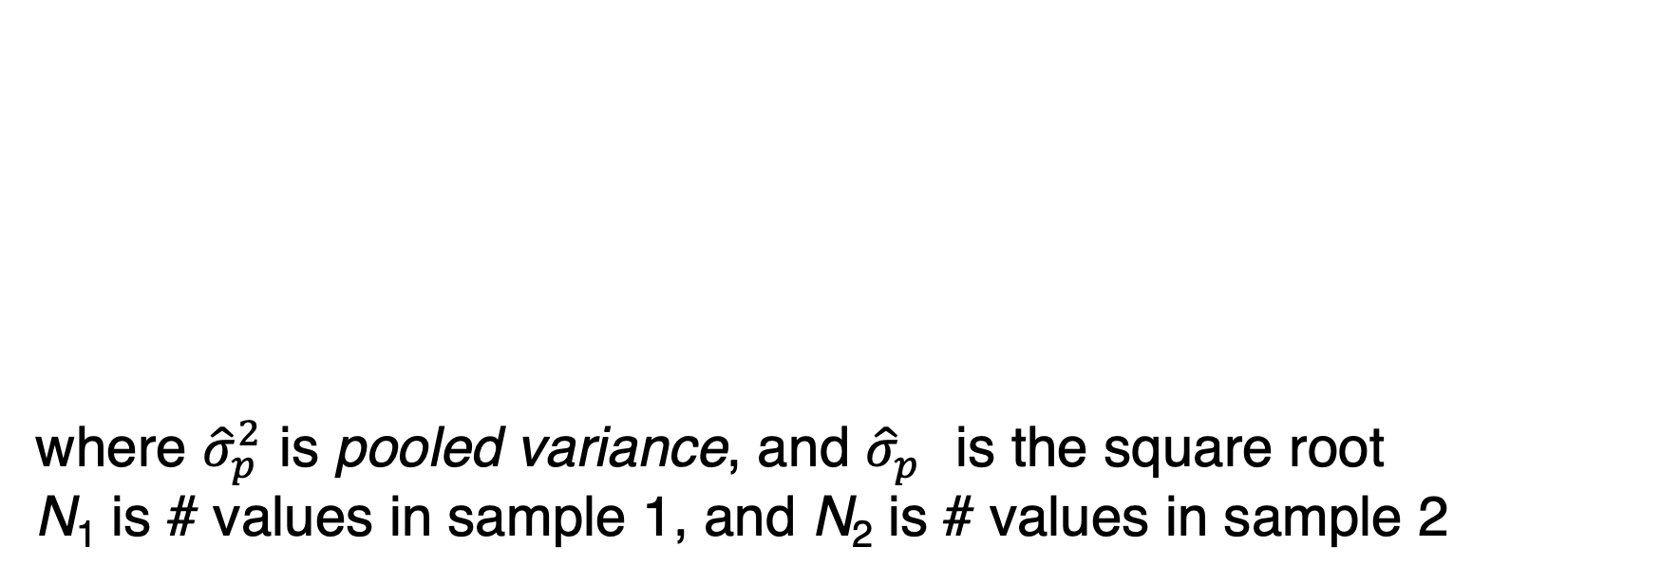
Notice: magnitude goes up as diff in means goes up or the variances go down
where ${\hat{σ}}_{p}^{2}$ is pooled variance, and ${\hat{σ}}_{p}^{}$ is the square root
N₁ is # values in sample 1, and N₂ is # values in sample 2

Slide 17
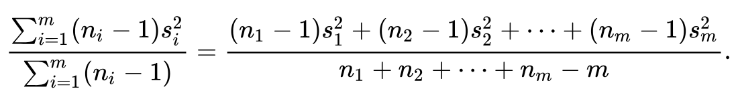
Pooled variance:
i.e. average of the sample variances, each weighted by its sample size

Slide 18
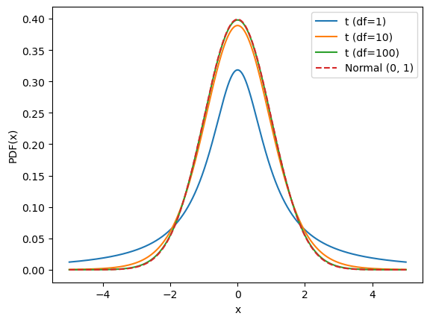

The t distribution is bell-shaped, but how narrowly peaked depends on deg. of freedom
Degrees of freedom:
I.e. sum of the sample sizes, minus two

Slide 19
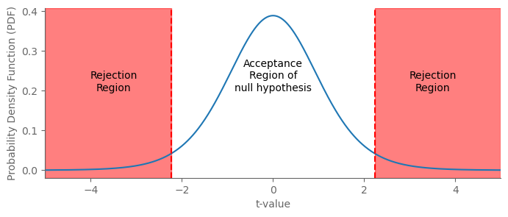
The threshold value of the test statistic defines acceptance and rejection regions

Slide 20
Most often, we’re looking for a difference in means of either sign: two-sided test
For 1900-1919 vs. 2000-2019 annual snow, for example, we simply want to know if the populations are different at all
This could happen if the 1900s mean > 2000s mean OR the opposite, 1900s mean < 2000s mean
Ignoring for now issue of the variance changing between them
So we only care about the magnitude, not sign of the statistic

Slide 21
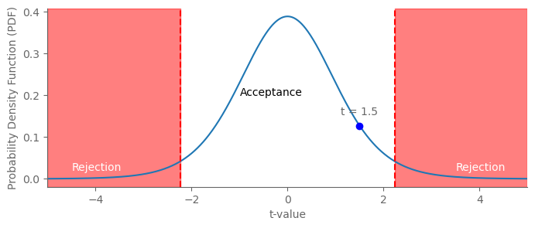
Imagine we performed our analysis and got t=1.5. What do we conclude?
Accept the null hypothesis!
I.e. no difference detected

Slide 22
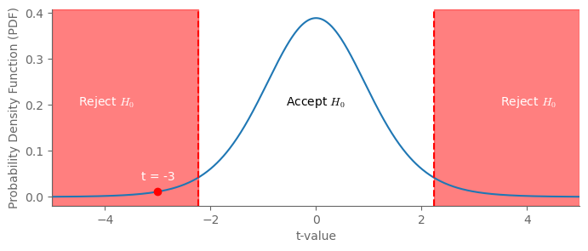
Now in a different case we get t=-3. What do we conclude this time?
Reject the null hypothesis!
I.e. difference detected

Slide 23
The choice of threshold is a tradeoff between false positives and false negatives
True positive = the alternative hypothesis really is true, and from our test statistic we conclude that it is true (good!)
True negative: same, but both false (also good!)
False positive: the alternative hypothesis is False, but our calculations tell us that it is True (bad!)
False negative: alternative hypothesis is True but we ID it False (also bad!)

Slide 24
The choice of threshold is a tradeoff between false positives and false negatives
The more stringent the threshold for rejecting the null hypothesis, the less likely to get false positives but more likely false negatives
And vice versa: less stringent threshold: less likely to get false negative but more likely to get false positives
Which matters more depends on the context
Common standard thresholds are 1, 5, and 10% levels

Slide 25

More stringent threshold = less false positives but more false negatives

Slide 26
If we get an insignificant t value, we still can’t say that we “reject” the alternative hypothesis
I.e. we can’t say, carte blanche, that the population means are identical
There’s a 5% chance (assuming the rejection threshold used was 5%) that the statistic would have landed in the rejection region even if the means were not identical
What we can say: “the test statistic value is insignificant at the 5% level.”

Slide 27
Accept/reject framework doesn’t distinguish by how much the threshold is met
In this example, t=-2.5 vs. t=-5 vs. t=-100 are all identical: reject H0
Even though t=-100 means the likelihood that H0 is true is way smaller

Slide 28
So we also report the p value: the probability of the observed result if H0 was true
E.g. p=0.01 means 1% chance of obtaining the observed or a more extreme value if H0 true
Recall: if null hypothesis is true, the two populations are identical
So any difference in the sample means was due to chance
So would lower or higher p value mean “more significant”, i.e. less likely that the difference was random?
A: lower.

Slide 29
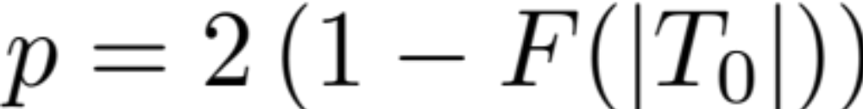
The corresponding p value is computed from the CDF of the t statistic
where F is the CDF is of the t distribution

Slide 30
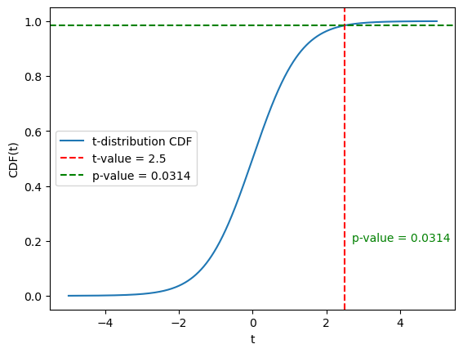
Example p value:
In this case, p=0.0314
So you would reject H0 at 10 and 5% decision thresholds but NOT if it was a 1% threshold

Slide 31
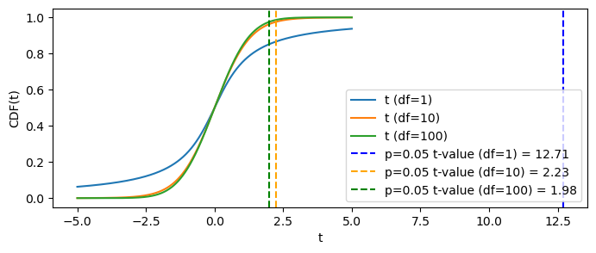
The smaller the sample size, the larger the t value required for a given p value
This plot: CDFs and their t value corresponding to p=0.05

Slide 32

Now let’s actually compute the test statistic
Upshot: the t statistic is computed with:
https://docs.scipy.org/doc/scipy/reference/generated/scipy.stats.ttest_ind.html

Slide 33
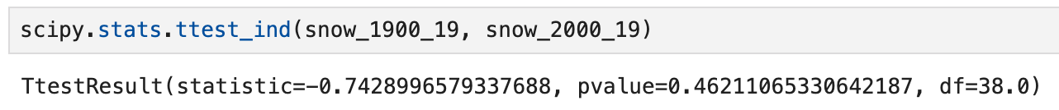
For 1900-1919 vs. 2000-2019 snow:
Don’t reject the null at any standard significance threshold.
So no difference detected

Slide 34
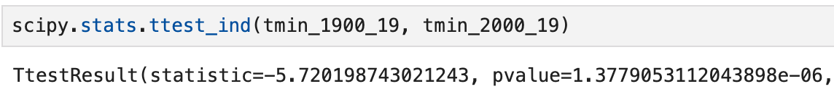
Now let’s switch: for 1900-1919 vs. 2000-2019 annual average minimum temperature:
Very statistically significant difference in the means.
So reject the null: it’s extremely likely the two samples came from populations w/ different means

Slide 35
What we’re covering today:
Now: assumptions underlying the t test

Slide 36
The t test makes several assumptions that quite often are not satisfied
It’s always possible to compute the t-test
But how to interpret the results of that test depends on how well these assumptions are met

Slide 37
t-test assumption #1: independence of observations
Each observation in the samples is independent of all the others
This is violated in the case of serially or spatially correlated data
We’ll formalize that in subsequent lectures via autocorrelation
Central Park example: daily min, max, and mean T are all highly correlated in time due to seasonal cycle and weather systems

Slide 38
t-test assumption #1: independence of observations
What about the annual snowfall values? There it’s not so obvious…does it tend to be snowier than usual or less snowy than usual multiple years in a row?

Slide 39
t-test assumption #2: both samples are drawn from normal distributions
For this one, we have to distinguish between theory and practice
Theory: the mathematical derivation of the t statistic requires assuming that the samples themselves are drawn from normal
Practice: the t test is ultimately about sample means…so if the sample size is large enough and data is ~iid, by CLT should be ok

Slide 40
t-test assumption #3: equal variance of the two samples
The math underlying the t distribution requires that the variances of the two samples are identical
In practice, they’ll virtually never be truly identical
How close is “close enough” for this to be satisfied? The relevant statistical test is the “F test”

Slide 41
t-test assumption #4: the samples are randomly sampled from the population(s) you are claiming them to be sampling
This one’s more “meta”: it’s not about the actual values of any particular quantities of either sample
It’s about what you can infer. In practice, it mostly boils down to limiting the scope of the populations.

Slide 42
t-test assumption #4: samples are randomly sampled from a well-defined population
From ChatGPT5: “A t-test is like measuring the salinity of an ocean with a few water samples. The math can be perfect, but if all your samples come from the same bay, your inferences about the “ocean” are off.”

Slide 43
t-test assumption #4: samples are randomly sampled from a well-defined population
But in that example, if you instead limit the scope of your inference to be about salinity within that bay, rather than the whole oceans, then this assumption is better satisfied
By narrowing the scope of inference, we stand on firmer footing in terms of how credible our resulting arguments are

Slide 44
What we’re covering today:
Decision rules and p values
The t test: testing difference in means
Other hypothesis tests (an extremely brief survey)

Slide 45
Hypothesis tests applied to linear regression
We want to rigorously assess the likelihood that the regression slope and/or correlation coefficient we compute is not due to chance
Q: should we use a t test for this?
A: No. This is not a difference in means.

Slide 46
But conceptually a t test and the test for regression slopes are very similar
In both cases: is this different from zero?
t test: is the difference between two means nonzero?
Regression: is this linear slope between the two variables nonzero

Slide 47
Other hypothesis tests: difference in variance; non-parametric tests
We’ll touch on these in the lab and HW

Slide 48
Confidence intervals
We’ll touch on these in the lab and HW

